Slide 1
Module 2 – Syntax Analysis
Bottom Up Parsing

Slide 2
Parsing Methods
Parsing
Top down parsing
Bottom up parsing (Shift reduce)
Back tracking
Operator precedence
Parsing without backtracking (predictive Parsing)
LR parsing
SLR
LL(1)
CLR
Recursive
descent
LALR

Slide 3
Handle & Handle pruning
Handle: A “handle” of a string is a substring of the string that matches the right side of a production, and whose reduction to the non terminal of the production is one step along the reverse of rightmost derivation.
Handle pruning: The process of discovering a handle and reducing it to appropriate left hand side non terminal is known as handle pruning.
E→E+E
E→E*E
E→id
String: id1+id2*id3
Right sentential form | Handle | Production
Rightmost Derivation
E
E+E
E+E*E
E+E*id3
E+id2*id3
id1+id2*id3
id1+id2*id3 | id1 | E→id
E+id2*id3 | id2 | E→id
E+E*id3 | id3 | E→id
E+E*E | E*E | E→E*E
E+E | E+E | E→E+E
E

Slide 4
Handle & Handle pruning
Rightmost Derivation
E
E+E
E+E*E
E+E*id3
E+id2*id3
id1+id2*id3
E→E+E
E→E*E
E→id
String: id1+id2*id3

Slide 5
Shift Reduce parser
The shift reduce parser performs following basic operations:
Shift: Moving of the symbols from input buffer onto the stack, this action is called shift.
Reduce: If handle appears on the top of the stack then reduction of it by appropriate rule is done. This action is called reduce action.
Accept: If stack contains start symbol only and input buffer is empty at the same time then that action is called accept.
Error: A situation in which parser cannot either shift or reduce the symbols, it cannot even perform accept action then it is called error action.

Slide 6
Example: Shift reduce parser
Grammar:
E→E+T | T
T→T*F | F
F→id
String: id+id*id
Stack | Input Buffer | Action
$ | id+id*id$ | Shift
$id | +id*id$ | Reduce F→id
$F | +id*id$ | Reduce T→F
$T | +id*id$ | Reduce E→T
$E | +id*id$ | Shift
$E+ | id*id$ | Shift
$E+id | *id$ | Reduce F→id
$E+F | *id$ | Reduce T→F
$E+T | *id$ | Shift
$E+T* | id$ | Shift
$E+T*id | $ | Reduce F→id
$E+T*F | $ | Reduce T→T*F
$E+T | $ | Reduce E→E+T
$E | $ | Accept

Slide 7
Viable Prefix
The set of prefixes of right sentential forms that can appear on the stack of a shift-reduce parser are called viable prefixes.

Slide 8
Parsing Methods
Parsing
Top down parsing
Bottom up parsing (Shift reduce)
Back tracking
Operator precedence
Parsing without backtracking (predictive Parsing)
LR parsing
SLR
LL(1)
CLR
Recursive
descent
LALR

Slide 9
Operator precedence parsing
Operator Grammar: A Grammar in which there is no Є in RHS of any production or no adjacent non terminals is called operator grammar.
Example: E→ EAE | (E) | id
A→ + | * | -
Above grammar is not operator grammar because right side EAE has consecutive non terminals.
In operator precedence parsing we define following disjoint relations:
Relation | Meaning
a<.b | a “yields precedence to” b
a=b | a “has the same precedence as” b
a.>b | a “takes precedence over” b

Slide 10
Precedence & associativity of operators
Operator | Precedence | Associative
↑ | 1 | right
*, / | 2 | left
+, - | 3 | left

Slide 11
Steps of operator precedence parsing
Find Leading and trailing of non-terminal
Establish relation
Creation of table
Parse the string

Slide 12
Leading & Trailing
Leading:- Leading of a non-terminal is the first terminal or operator in production of that non-terminal.
Trailing:- Trailing of a non-terminal is the last terminal or operator in production of that non-terminal.
Example: E→E+T | T
T→T*F | F
F→id
Non terminal | Leading | Trailing
E | {+,*,id} | {+,*,id}
T | {*,id} | {*,id}
F | {id} | {id}

Slide 13

Rules to establish a relation
For a = b, $⇒ aAb$, where $A$ is $ε$ or a single non terminal [e.g : (E)]
a <.b$⇒Op .NT then Op <. Leading\left(NT\right)$ [e.g : +T]
a .>b$⇒NT . Op then \left(Trailing(NT\right)) .>Op$ [e.g : E+]
$ <. Leading (start symbol)
Trailing (start symbol) .> $

Slide 14

Example: Operator precedence parsing
a <.b
$Op .NT Op <. Leading\left(NT\right)$
$+T + <. \left\{∗,id\right\}$
$∗F ∗ <. \{id\}$
Step 1: Find Leading & Trailing of NT
E→ E
+T
| T
Nonterminal | Leading | Trailing
T→ T
| F
*F
E | {+,*,id} | {+,*,id}
F→ id
T | {*,id} | {*,id}
F | {id} | {id}
Step 2: Establish Relation
Step3: Creation of Table
 | + | * | id | $
+ | .> | <. | <. | .>
* | .> | .> | <. | .>
id | .> | .> |  | .>
$ | <. | <. | <.

Slide 15

Example: Operator precedence parsing
a .>b
$NT . Op \left(Trailing(NT\right)).>Op$
$E+ \left\{+,∗,id\right\}.> +$
$T∗ \{∗,id\}.>∗$
Step 1: Find Leading & Trailing of NT
E→
E+
T| T
Nonterminal | Leading | Trailing
T→
F| F
T*
E | {+,*,id} | {+,*,id}
F→ id
T | {*,id} | {*,id}
F | {id} | {id}
Step2: Establish Relation
Step3: Creation of Table
 | + | * | id | $
+ | .> | <. | <. | .>
* | .> | .> | <. | .>
id | .> | .> |  | .>
$ | <. | <. | <.

Slide 16
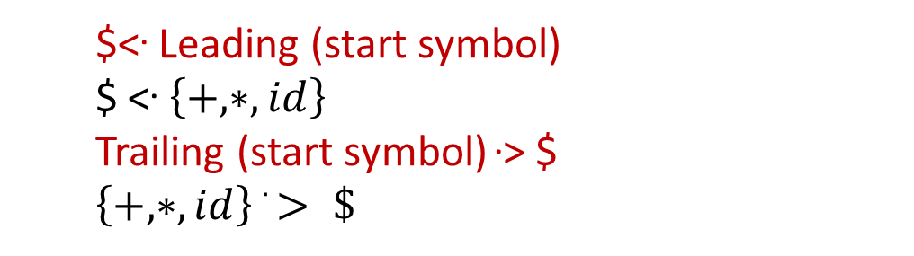
Example: Operator precedence parsing
Step 1: Find Leading & Trailing of NT
E→
E+
T| T
Nonterminal | Leading | Trailing
T→
F| F
T*
E | {+,*,id} | {+,*,id}
F→ id
T | {*,id} | {*,id}
F | {id} | {id}
Step 3: Creation of Table
Step 2: Establish Relation
 | + | * | id | $
$<. Leading (start symbol)
$ <. $\left\{+,∗,id\right\}$
Trailing (start symbol) .> $
$\left\{+,∗,id\right\} .> \$$
+ | .> | <. | <. | .>
* | .> | .> | <. | .>
id | .> | .> |  | .>
$ | <. | <. | <.

Slide 17
Example: Operator precedence parsing
Assign precedence operator between terminals
String: id+id*id
$ id+id*id $
$ <. id+id*id$
$ <. id .> +id*id$
$ <. id .> + <. id*id$
$ <. id .> + <. id .> *id$
$ <. id .> + <. id .> *<. id$
$ <. id .> + <. id .> *<. id .> $
Step 4: Parse the string using precedence table
 | + | * | id | $
+ | .> | <. | <. | .>
* | .> | .> | <. | .>
id | .> | .> |  | .>
$ | <. | <. | <.

Slide 18
Example: Operator precedence parsing
Step 4: Parse the string using precedence table
Scan the input string until first .> is encountered.
Scan backward until <. is encountered.
The handle is string between <. and .>
$ <. Id .> + <. Id .> * <. Id .> $ | Handle id is obtained between <. and .> Reduce this by F→id
$ F + <. Id .> * <. Id .> $ | Handle id is obtained between <. and .> Reduce this by F→id
$ F + F * <. Id .> $ | Handle id is obtained between <. and .> Reduce this by F→id
$ F + F * F $ | Perform appropriate reductions of all nonterminals.
$ E + T * F $ | Remove all non terminals.
$ + * $ | Place relation between operators
$ <. + <. * >$ | The * operator is surrounded by <. and .>. This indicates * becomes handle so reduce by T→T*F.
$ <. + >$ | + becomes handle. Hence reduce by E→E+T.
$ $ | Parsing Done

Slide 19
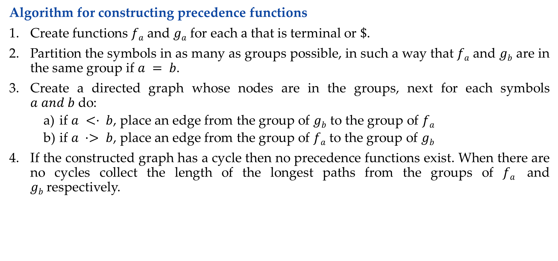
Operator precedence function
Algorithm for constructing precedence functions
Create functions $fa$ and $ga$ for each $a$ that is terminal or $\$$.
Partition the symbols in as many as groups possible, in such a way that $fa$ and $gb$ are in the same group if $a = b$.
Create a directed graph whose nodes are in the groups, next for each symbols $a and b$do:
        if $a <· b$, place an edge from the group of $gb$ to the group of $fa$
        if $a ·> b$, place an edge from the group of $fa$ to the group of $gb$
If the constructed graph has a cycle then no precedence functions exist. When there are no cycles collect the length of the longest paths from the groups of $fa$ and $gb$respectively.

Slide 20

Operator precedence function
Create functions f_{a} and g_{a} for each a that is terminal or $.
$a= \{+,∗,id\} or \$$
E→ E+T | T
T→ T*F | F F→ id
f₊
f*
f_{id}
f$
g₊
g*
g_{id}
g$

Slide 21
Operator precedence function
Partition the symbols in as many as groups possible, in such a way that f_{a} and g_{b} are in the same group if a = b.
.
 | + | * | id | $
g_{id}
f_{id}
+ | .> | <. | <. | .>
* | .> | .> | <. | .>
id | .> | .> |  | .>
$ | <. | <. | <.
f*
g*
g₊
f₊
f$
g$

Slide 22
Operator precedence function
        if a <· b, place an edge from the group of g_{b} to the group of f_{a}
        if a ·> b, place an edge from the group of f_{a} to the group of g_{b}
g
f
 | + | * | id | $
g_{id}
f_{id}
+ | .> | <. | <. | .>
* | .> | .> | <. | .>
id | .> | .> |  | .>
$ | <. | <. | <.
f*
g*
g₊
f₊
f₊ .> g₊
f₊ → g₊
f* .> g₊
f* → g₊
f_{id} .> g₊
f_{id} → g₊
f$
g$
f$ <. g₊
f$ ← g₊

Slide 23
Operator precedence function
        if a <· b, place an edge from the group of g_{b} to the group of f_{a}
        if a ·> b, place an edge from the group of f_{a} to the group of g_{b}
g
f
 | + | * | id | $
g_{id}
f_{id}
+ | .> | <. | <. | .>
* | .> | .> | <. | .>
id | .> | .> |  | .>
$ | <. | <. | <.
f*
g*
g₊
f₊
f₊ <. g*
f₊ ← g*
f* .> g*
f* → g*
f_{id} .> g*
f_{id} → g*
f$
g$
f$ <. g*
f$ ← g*

Slide 24
Operator precedence function
        if a <· b, place an edge from the group of g_{b} to the group of f_{a}
        if a ·> b, place an edge from the group of f_{a} to the group of g_{b}
g
f
 | + | * | id | $
g_{id}
f_{id}
+ | .> | <. | <. | .>
* | .> | .> | <. | .>
id | .> | .> |  | .>
$ | <. | <. | <.
f*
g*
g₊
f₊
f₊ <. g_{id}
f₊ ← g_{id}
f* <. g_{id}
f* ← g_{id}
f$ <. g_{id}
f$ ← g_{id}
f$
g$

Slide 25
Operator precedence function
        if a <· b, place an edge from the group of g_{b} to the group of f_{a}
        if a ·> b, place an edge from the group of f_{a} to the group of g_{b}
g
f
 | + | * | id | $
g_{id}
f_{id}
+ | .> | <. | <. | .>
* | .> | .> | <. | .>
id | .> | .> |  | .>
$ | <. | <. | <.
f*
g*
g₊
f₊
f₊ <. g$
f₊ → g$
f* <. g$
f* → g$
f_{id} <. g$
f_{id} → g$
f$
g$

Slide 26
Operator precedence function
 | + | * | id | $
f | 2
g_{id}
f_{id}
g
f*
g*
If the constructed graph has a cycle then no precedence functions exist. When there are no cycles collect the length of the longest paths from the groups of f_{a} and g_{b} respectively.
g₊
f₊
f$
g$

Slide 27
Operator precedence function
 | + | * | id | $
g_{id}
f_{id}
f | 2
g | 1
f*
g*
g₊
f₊
f$
g$

Slide 28
Operator precedence function
 | + | * | id | $
g_{id}
f_{id}
f | 2 | 4
g | 1
f*
g*
g₊
f₊
f$
g$

Slide 29
Operator precedence function
 | + | * | id | $
g_{id}
f_{id}
f | 2 | 4
g | 1 | 3
f*
g*
g₊
f₊
f$
g$

Slide 30
Operator precedence function
 | + | * | id | $
g_{id}
f_{id}
f | 2 | 4 | 4
g | 1 | 3
f*
g*
g₊
f₊
f$
g$

Slide 31
Operator precedence function
 | + | * | id | $
g_{id}
f_{id}
f | 2 | 4 | 4
g | 1 | 3 | 5
f*
g*
g₊
f₊
f$
g$

Slide 32
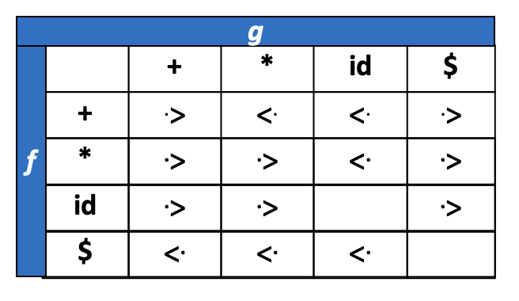
Operator precedence function
 | + | * | id | $
g_{id}
f_{id}
f | 2 | 4 | 4 | 0
g | 1 | 3 | 5 | 0
f*
g*
g₊
f₊
f$
g$

Slide 33
Parsing Methods
Parsing
Top down parsing
Bottom up parsing (Shift reduce)
Back tracking
Operator precedence
Parsing without backtracking (predictive Parsing)
LR parsing
SLR
LL(1)
CLR
Recursive
descent
LALR

Slide 34
LR parser
LR parsing is most efficient method of bottom up parsing which can be used to parse large class of context free grammar.
The technique is called LR(k) parsing:
The “L” is for left to right scanning of input symbol,
The “R” for constructing right most derivation in reverse,
The “k” for the number of input symbols of look ahead that are used in making parsing decision.
a | + | b | $
INPUT
X
Y
Z
$
LR parsing program
OUTPUT
Parsing Table
Action
Goto

Slide 35
Parsing Methods
Parsing
Top down parsing
Bottom up parsing (Shift reduce)
Back tracking
Operator precedence
Parsing without backtracking (predictive parsing)
LR parsing
SLR
LL(1)
CLR
Recursive
descent
LALR

Slide 36
Computation of closure & go to function
X→ Xb
Closure(I):
X→ X b
Goto(I,X)
X→ X b
.
.

Slide 37
Steps to construct SLR parser
Construct Canonical set of LR(0) items
Construct SLR parsing table
Parse the input string

Slide 38







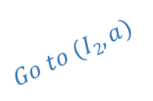


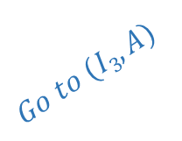








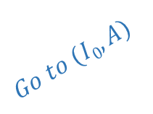
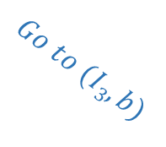
Example: SLR(1)- simple LR
S → AA
A → aA | b
S→ AA .
$I$₅
S’→ S.
$$I1$$
$$Go to (I2,A)$$
A→ a . A
$$Go to (I0,S)$$
$$I2$$
A→. aA
$I$₃
$$I0$$
S→ A . A
A→. b
S’→.S
$$Go to (I2,a)$$
$$Go to (I0,A)$$
A→. aA
S→. AA
A→. b
A→ b.
$I$₄
A→. aA
$$Go to (I2,b)$$
A→. b
$$Go to (I0,a)$$
LR(0) item set
$I$₃
A→ aA .
$I$₆
$$Go to (I3,A)$$
Augmented grammar
A→ a . A
$$Go to (I0,b)$$
A→. aA
$$Go to (I3,a)$$
A→ a . A
$I$₄
A→. b
A→. aA
$I$₃
A→ b.
$$Go to (I3,b)$$
A→. b
A→ b.
$I$₄

Slide 39
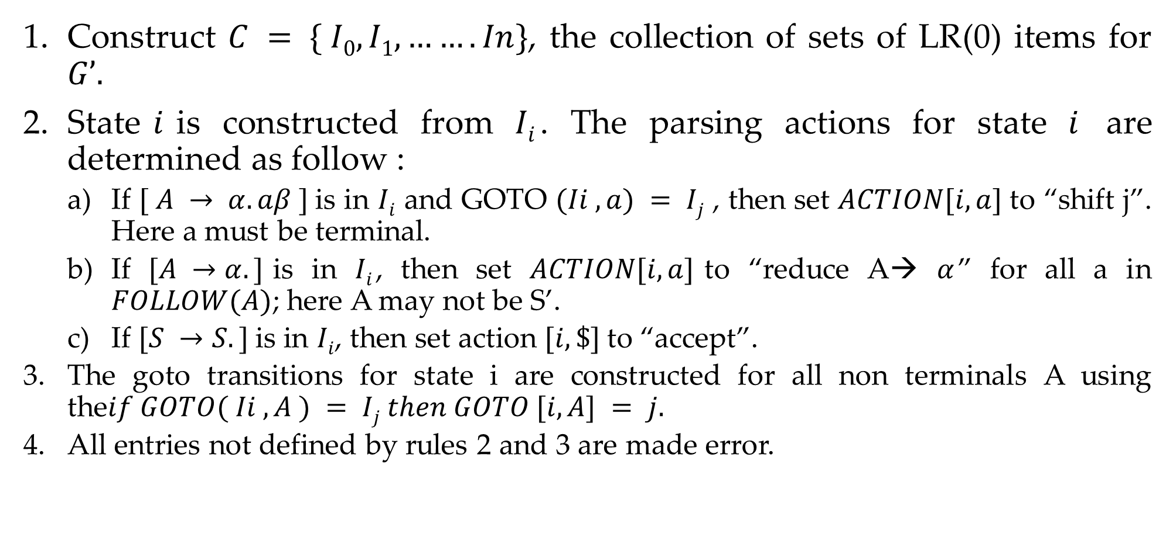
Rules to construct SLR parsing table
Construct $C = \{ I0, I1, ……. In\}$, the collection of sets of LR(0) items for $G’.$
State$i$is constructed from $Ii$. The parsing actions for state $i$ are determined as follow :
  If $[ A → α.aβ ]$is in $Ii$ and GOTO $(Ii , a) = Ij$ , then set $ACTION[i, a]$to “shift j”. Here a must be terminal.
  If $[A →α.]$is in $Ii$, then set $ACTION[i, a]$to “reduce A→ $α$” for all a in $FOLLOW(A)$; here A may not be S’.
  If $[S →S.]$is in $Ii$, then set action $[i, \$]$to “accept”.
  The goto transitions for state i are constructed for all non terminals A using the$if GOTO( Ii , A ) = Ij then GOTO [i, A] = j.$
  All entries not defined by rules 2 and 3 are made error.

Slide 40







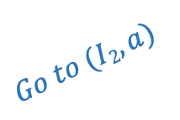












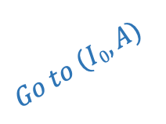
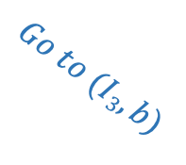
Example: LR(0) and SLR(1) Parsing Tables
 | Action |  |  | Go to
Item set | a | b | $ | S | A
0 | S3 | S4 |  | 1 | 2
1 |  |  | Accept
2 | S3 | S4 |  |  | 5
3 | S3 | S4 |  |  | 6
4 | R3 | R3 | R3
5 |  |  | R1
6 | R2 | R2 | R2
$$Follow(S)=\{\$\}$$
$$Follow(A)=\{a, b, \$\}$$
S→ AA .
$I$₅
S’→ S.
$$I1$$
$$Go to (I2,A)$$
A→ a . A
LR(0)
$$Go to (I0,S)$$
$$I2$$
A→. aA
$I$₃
$$I0$$
 | Action |  |  | Go to
IS | a | b | $ | S | A
0 | S3 | S4 |  | 1 | 2
1 |  |  | Acc
2 | S3 | S4 |  |  | 5
3 | S3 | S4 |  |  | 6
4 | R3 | R3 | R3
5 | R1 | R1 | R1
6 | R2 | R2 | R2
S→ A . A
A→. b
S’→. S
$$Go to (I2,a)$$
$$Go to (I0,A)$$
A→. aA
S→. AA
A→. b
A→ b.
$I$₄
A→. aA
$$Go to (I2,b)$$
A→. b
$$Go to (I0,a)$$
$I$₃
A→ aA .
$I$₆
$$Go to (I3,A)$$
A→ a . A
$$Go to (I0,b)$$
SLR(1)
A→. aA
$$Go to (I3,a)$$
A→ a . A
$I$₄
A→. b
A→. aA
$I$₃
A→ b.
$$Go to (I3,b)$$
A→. b
LR(0) and SLR(1) are two different parsers
S → AA
A → aA | b
A→ b.
$I$₄

Slide 41
Parsing Methods
Parsing
Top down parsing
Bottom up parsing (Shift reduce)
Back tracking
Operator precedence
Parsing without backtracking (predictive Parsing)
LR parsing
SLR
LL(1)
CLR
Recursive
descent
LALR

Slide 42

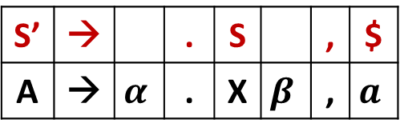

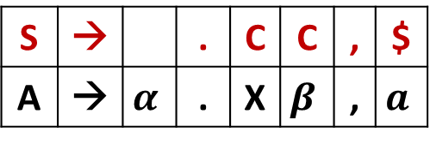
How to calculate look ahead?
How to calculate look ahead?
S→CC
C→ cC | d
Closure(I)
S’→.S,$
S→.CC,
C→.cC,
C→.d,
S’ | → |  | . | S |  | , | $
A | → | $$α$$ | . | X | $$β$$ | , | $$a$$
$$Lookahead=First\left(βa\right)$$
$$First\left(\$\right)$$
$$=\$$$
$
S | → |  | . | C | C | , | $
A | → | $$α$$ | . | X | $$β$$ | , | $$a$$
c|d
c|d
$$Lookahead=First\left(βa\right)$$
$$First\left(C\$\right)$$
$$=c,d$$

Slide 43



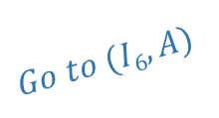




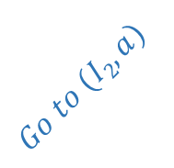



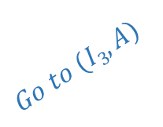














Example: CLR(1)- canonical LR
$I$₅
$I$₆
A→ aA.,$
$I$₉
S→ AA. ,$
A→ a.A,$
$I$₆
S’→ S., $
$$I1$$
$$Go to (I6,A)$$
A→ a.A,$
$$Go to (I2,A)$$
A→. aA,$
$$Go to (I0,S)$$
$$I2$$
$$Go to (I6,a)$$
$$I0$$
A→. aA,$
S→ A.A,$
$$Go to (I2,a)$$
A→. b, $
$$Go to (I6,b)$$
S’→.S,$
A→ b. ,S
A→. b, $
A→.aA, $
$I$₇
$I$₇
S→.AA,$
$$Go to (I0,A)$$
A→ b. ,$
A→. b, $
$$Go to (I2,b)$$
A→.aA, a|b
$I$₈
A→.b, a|b
LR(1) item set
$I$₃
A→ aA.,a|b
$$Go to (I3,A)$$
Augmented grammar
$$Go to (I0,a)$$
A→a.A, a|b
$I$₃
$$Go to (I0,b)$$
A→.aA ,a|b
$$Go to (I3,a)$$
A→ a.A , a|b
A→ b., a|b
A→. b, a|b
A→.aA , a|b
$I$₄
$$Go to (I3,b)$$
A→.b , a|b
S → AA
A → aA | b
$I$₄
A→ b., a|b

Slide 44
Example: CLR(1)- canonical LR
$I$₅
$I$₆
A→ aA.,$
$I$₉
S→ AA. ,$
A→ a.A,$
$I$₆
S’→ S., $
$$I1$$
$$Go to (I6,A)$$
A→ a.A,$
$$Go to (I2,A)$$
A→. aA,$
$$Go to (I0,S)$$
$$I2$$
$$Go to (I6,a)$$
$$I0$$
A→. aA,$
S→ A.A,$
$$Go to (I2,a)$$
A→. b, $
$$Go to (I6,b)$$
S’→.S,$
A→ b. ,S
A→. b, $
A→.aA, $
$I$₇
$I$₇
S→.AA,$
$$Go to (I0,A)$$
A→ b. ,S
A→. b, $
$$Go to (I2,b)$$
Item set | Action |  |  | Go to
 | a | b | $ | S | A
0 | S3 | S4 |  | 1 | 2
1 |  |  | Accept
2 | S6 | S7 |  |  | 5
3 | S3 | S4 |  |  | 8
4 | R3 | R3
5 |  |  | R1
6 | S6 | S7 |  |  | 9
7 |  |  | R3
8 | R2 | R2
9 |  |  | R2
A→.aA, a|b
$I$₈
A→.b, a|b
$I$₃
A→ aA.,a|b
$$Go to (I3,A)$$
$$Go to (I0,a)$$
A→a.A, a|b
$I$₃
$$Go to (I0,b)$$
A→.aA ,a|b
$$Go to (I3,a)$$
A→ a.A , a|b
A→ b., a|b
A→. b, a|b
A→.aA , a|b
$I$₄
$$Go to (I3,b)$$
A→.b , a|b
S → AA
A → aA | b
$I$₄
A→ b., a|b

Slide 45
Parsing Methods
Parsing
Top down parsing
Bottom up parsing (Shift reduce)
Back tracking
Operator precedence
Parsing without backtracking (predictive Parsing)
LR parsing
SLR
LL(1)
CLR
Recursive
descent
LALR

Slide 46



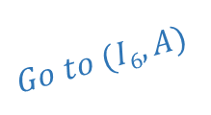






















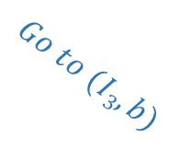


Example: LALR(1)- look ahead LR
$I$₅
$I$₆
A→ aA.,$
$I$₉
S→ AA. ,$
A→ a.A,$
$I$₆
S’→ S., $
$$I1$$
$$Go to (I6,A)$$
A→ a.A,$
$$Go to (I2,A)$$
A→. aA,$
$$Go to (I0,S)$$
$$I2$$
$$Go to (I6,a)$$
$$I0$$
A→. aA,$
S→ A.A,$
$$Go to (I2,a)$$
A→. b, $
$$Go to (I6,b)$$
S’→.S,$
A→ b. ,$
A→. b, $
A→.aA, $
$I$₇
$I$₇
S→.AA,$
$$Go to (I0,A)$$
A→ b. ,$
A→. b, $
$$Go to (I2,b)$$
A→.aA, a|b
CLR
$I$₈
$I$₃₆
A→.b, a|b
$I$₃
A→ aA.,a|b
A→a.A, a|b|$
$$Go to (I3,A)$$
$$Go to (I0,a)$$
A→.aA , a|b|$
A→a.A, a|b
$I$₃
$$Go to (I0,b)$$
A→. b, a|b|$
A→.aA ,a|b
$$Go to (I3,a)$$
A→ a.A , a|b
A→ b., a|b
A→. b, a|b
A→.aA , a|b
$I$₄₇
$I$₄
$$Go to (I3,b)$$
A→.b , a|b
A→ b., a|b|$
S → AA
A → aA | b
$I$₈₉
$I$₄
A→ b., a|b
A→ aA.,a|b|$

Slide 47
Example: LALR(1)- look ahead LR
Item set | Action |  |  | Go to
 | a | b | $ | S | A
0 | S3 | S4 |  | 1 | 2
1 |  |  | Accept
2 | S6 | S7 |  |  | 5
3 | S3 | S4 |  |  | 8
4 | R3 | R3
5 |  |  | R1
6 | S6 | S7 |  |  | 9
7 |  |  | R3
8 | R2 | R2
9 |  |  | R2
Item set | Action |  |  | Go to
 | a | b | $ | S | A
0 | S36 | S47 |  | 1 | 2
1 |  |  | Accept
2 | S36 | S47 |  |  | 5
36 | S36 | S47 |  |  | 89
47 | R3 | R3 | R3
5 |  |  | R1
89 | R2 | R2 | R2
CLR Parsing Table
LALR Parsing Table

